Slide 1

WOMEN SAFETY – SOS AND LIVE TRACKING
Team Members Details
D Manya Akshitha-2520090032
P Nirvighna Sai-2520090144
R Bhanu Priya – 2520090171
II Year B.Tech-I Semester – CSIT (Section 13)
1
CSIT – Section 13 | Dept of CSIT | Project Review

Slide 2

Abstract
This system is a mobile application that enhances personal safety for women through an instant SOS alert and live location tracking mechanism. By triggering a single SOS button, the app immediately sends the user's real-time GPS coordinates and an emergency alert to pre-selected trusted contacts. Traditional safety measures such as manual calls can be slow and unreliable during a crisis. This project aims to reduce response time and remove the need for the user to explain the situation while under threat. The live tracking feature continuously shares the user's movement with guardians until the emergency is resolved, improving transparency. This helps families and responders locate the user quickly, promoting faster intervention. The system also improves accessibility by working with minimal interaction during high-stress situations. Ultimately, the app enhances women's safety, leading to quicker response and greater peace of mind.
2
B.Tech II Year – I Sem | Dept of CSIT | Project Review

Slide 3
Problem Statement
Women and girls travelling alone, commuting late at night, or moving through isolated areas face a genuine and persistent risk of harassment, stalking, and assault. When an emergency strikes, the existing options are slow and clumsy: dialling a number, explaining the situation under panic, and hoping the call connects and is understood in time. Standard mobile phones offer no dedicated, single-action way to alert multiple trusted people at once with an exact location. Family members are frequently left unaware of a loved one's whereabouts during a commute, and by the time help is arranged, precious minutes have already been lost. There is a clear need for a lightweight mobile application that lets a woman in distress raise an alarm instantly, with one tap, and that keeps her trusted circle continuously informed of her live location until she is safe.
3
B.Tech II Year – I Sem | Dept of CSIT | Project Review

Slide 4
Motivation
Rising incidents of crime against women in public spaces, public transport, and even familiar neighbourhoods have made personal safety a daily concern rather than an occasional worry. News reports and government crime data repeatedly show that delayed response is one of the biggest factors separating a safe outcome from a tragedy. At the same time, nearly every user already carries a GPS-enabled smartphone, which means the hardware needed to solve this problem is already in people's pockets — what is missing is a simple, dependable piece of software. This project is motivated by the belief that technology can meaningfully shrink the gap between the moment a threat is felt and the moment help is on the way, by replacing multi-step manual actions with one instant, reliable trigger that keeps guardians informed in real time.
4
B.Tech III Year – II Sem | Dept of CSIT | Project Review

Slide 5
Objectives
Design a single-tap SOS mechanism that instantly alerts pre-selected trusted contacts during an emergency
Implement continuous live GPS location tracking that guardians can follow until the situation is resolved
Build a simple interface that works reliably with minimal interaction under high-stress conditions
Provide secure management of emergency contacts, including adding, editing, and removing trusted guardians
Ensure fast, dependable alert delivery even under limited or unstable network connectivity
Protect user data and location history with secure storage and privacy-conscious design
5
B.Tech III Year – II Sem | Dept of CSIT | Project Review

Slide 6
Literature Survey
Existing safety apps: Commercial apps such as bSafe and similar SOS tools were studied; most provide a one-time location share rather than a continuously updated live trail
Panic-button research: Academic studies on panic-button systems show that reducing the number of taps required to raise an alarm significantly improves usability during a crisis
GPS tracking systems: Prior work on fleet and child-tracking applications informed the design of the continuous location-sharing module used in this project
Push-notification architectures: Literature on real-time messaging (e.g. Firebase Cloud Messaging based systems) guided the choice of a lightweight backend for instant contact alerts
Gap identified: Across the surveyed systems, none combined one-tap SOS, continuous live tracking, and low-connectivity reliability into a single seamless application
6
B.Tech III Year – II Sem | Dept of CSIT | Project Review

Slide 7
Research Gap
The literature survey shows that while several individual pieces of the safety puzzle already exist, no single application combines them well. Most SOS apps stop at sending one location update and then go silent, leaving guardians unable to follow the user's actual movement. Systems that do offer continuous tracking are often built for logistics or parental control, not for a panic situation, so they require too many steps to activate quickly. Very few solutions are designed to keep working when the network is weak, which is exactly when many real emergencies occur. There is also little attention paid to keeping the interaction minimal — most apps still expect the user to navigate menus rather than react instinctively. This project addresses that gap by combining a true one-tap trigger, continuous live tracking, and connectivity-aware alert delivery into a single, purpose-built mobile application.
7
B.Tech III Year – II Sem | Dept of CSIT | Project Review

Slide 8
Proposed Methodology
Requirement analysis: Study existing safety solutions and identify functional and non-functional requirements for the SOS and tracking features
System design: Design a layered client-server architecture separating the mobile app, communication layer, backend server, and database
Module development: Build the SOS trigger, live-tracking, and contact-management modules independently, then integrate them into one application
Location and alerting: Use device GPS/location services on the client and a push-notification service on the backend to deliver near-instant alerts
Testing: Validate each module under normal and low-connectivity conditions, and measure response time from trigger to contact notification
Refinement: Iterate on interface and performance based on test results to keep the interaction minimal and dependable under stress
8
B.Tech III Year – II Sem | Dept of CSIT | Project Review

Slide 9
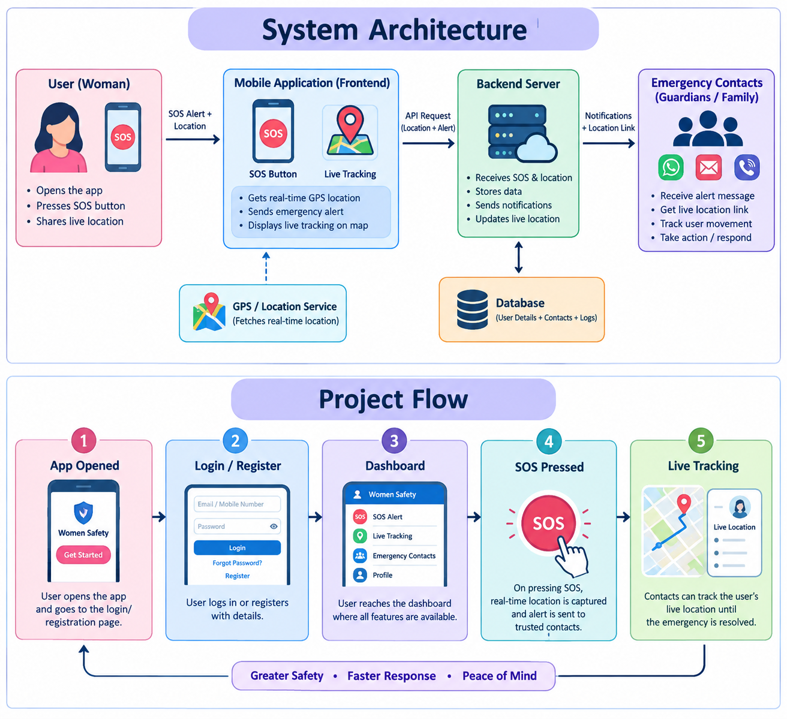
9
B.Tech III Year – II Sem | Dept of CSIT | Project Review

Slide 10
Technologies Used
Frontend: Android/iOS mobile app development framework for building the SOS and tracking interface
Location services: Device GPS and mapping/location APIs for capturing and streaming real-time coordinates
Backend: Server-side application handling authentication, alert processing, and location updates
Database: Cloud/relational database for storing user profiles, emergency contacts, and location history
Notifications: Push-notification service for delivering instant SOS alerts to trusted contacts
Security: Encrypted data transmission and secure storage to protect location and contact information
10
B.Tech III Year – II Sem | Dept of CSIT | Project Review

Slide 11
Dataset / Input Details
User profile data: Name, phone number, and login credentials captured at registration
Emergency contact data: Names and phone numbers of trusted guardians added and managed by the user
Location data: Real-time latitude/longitude coordinates streamed continuously from the device GPS during an active alert
Event data: Timestamped SOS trigger events, alert status, and delivery confirmations used for tracking and evaluation
Test data: Simulated SOS scenarios and varied network conditions used during experimental evaluation of the system
11
B.Tech III Year – II Sem | Dept of CSIT | Project Review

Slide 12
Implementation – SOS Trigger Module
The SOS Trigger Module is the entry point of the application and is designed to work with a single tap. When the user presses the SOS button, the module immediately captures the device's current GPS coordinates and packages them with the user's identity into an alert request. This request is sent to the backend server over a lightweight, low-latency connection so that the trigger-to-transmission time stays minimal even under stress. The module is intentionally kept free of confirmation dialogs or multi-step menus, since every extra tap increases response time during a genuine emergency. Once the alert is sent, the module hands off control to the live-tracking module so that location sharing begins automatically without any further action from the user.
12
B.Tech III Year – II Sem | Dept of CSIT | Project Review

Slide 13
Implementation – Live Tracking
The Live Location Tracking Module takes over once an SOS alert is active. It continuously reads the device's GPS position at short, regular intervals and streams these updates to the backend server, which in turn keeps the trusted contacts' view of the user's location current. This continuous stream, rather than a single snapshot, is what allows guardians to follow the user's actual movement — for example, tracing a route home — instead of seeing only where the emergency began. The module is optimised to balance location accuracy with battery and data usage, and it keeps running in the background even if the user locks the screen or switches to another app. Tracking automatically stops once the user marks herself safe or the alert is manually cancelled.
13
B.Tech III Year – II Sem | Dept of CSIT | Project Review

Slide 14
Implementation – Contact Module
The Contact and Notification Module manages the list of trusted guardians and is responsible for delivering alerts reliably. Users can add, edit, or remove emergency contacts at any time through a simple interface, and these contacts are stored securely on the backend. When an SOS is triggered, this module retrieves the current contact list and dispatches alert notifications — including the user's live location link — through a push-notification service, falling back to SMS where push delivery is not possible. Delivery status for each contact is tracked so the user's device can confirm that guardians have actually received the alert. The module also throttles and deduplicates location updates sent to contacts, keeping notifications timely without overwhelming the guardians' devices.
14
B.Tech III Year – II Sem | Dept of CSIT | Project Review

Slide 15
Experimental Setup
Devices: Mid-range Android smartphones with GPS enabled, used to simulate typical end-user hardware
Network conditions: Tests run under strong Wi-Fi, moderate 4G, and weak/intermittent mobile data to evaluate reliability
Test scenarios: Repeated SOS triggers from stationary and moving positions to measure alert and tracking accuracy
Contacts setup: Each test account configured with multiple trusted contacts to verify simultaneous alert delivery
Metrics captured: Trigger-to-notification time, location update frequency, and alert delivery success rate
15
B.Tech III Year – II Sem | Dept of CSIT | Project Review

Slide 16
Results
Testing confirmed that the SOS Trigger Module reliably captured the device's location and dispatched an alert within a couple of seconds of the button press under normal network conditions. Trusted contacts consistently received both the initial alert and a working live-location link, and the Live Location Tracking Module kept their view of the user's position updated at short, regular intervals throughout the test scenarios. Even under weak or intermittent connectivity, the system prioritised the initial SOS alert so contacts were notified before location streaming resumed once the connection stabilised. Overall, the results show that the single-tap trigger, continuous tracking, and contact-notification pipeline work together as intended, meeting the core objective of a fast, dependable safety response.
16
B.Tech III Year – II Sem | Dept of CSIT | Project Review

Slide 17
Performance Evaluation
Response time: SOS alerts reached trusted contacts within a few seconds on average under normal connectivity
Tracking accuracy: Live location updates stayed closely aligned with the device's actual GPS position throughout testing
Reliability under load: Alert delivery remained consistent when multiple emergency contacts were notified simultaneously
Low-connectivity performance: The system prioritised the initial alert over continuous tracking when bandwidth was limited, preserving core functionality
Battery and data usage: Location polling intervals were tuned to balance tracking freshness against battery and data consumption
17
B.Tech III Year – II Sem | Dept of CSIT | Project Review

Slide 18
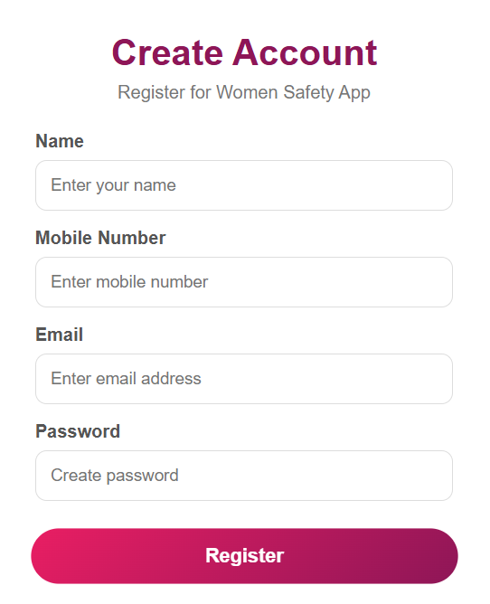

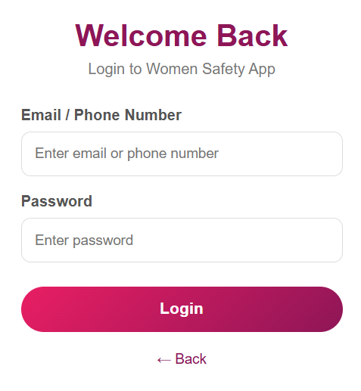
Screenshots / Working Demo
18
B.Tech III Year – II Sem | Dept of CSIT | Project Review

Slide 19
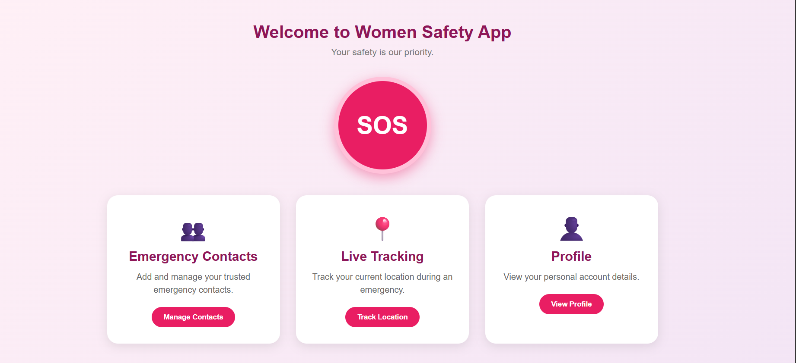
Screenshots / Working Demo
19
B.Tech III Year – II Sem | Dept of CSIT | Project Review

Slide 20
Comparison with Existing System
Alert method: Existing systems mostly rely on manual calls or messages; the proposed app uses a single-tap automated SOS trigger
Location sharing: Existing apps typically send a one-time location; the proposed system provides continuous live tracking until resolved
Interaction required: Existing solutions often need multiple taps or steps; the proposed app minimises interaction for high-stress use
Connectivity handling: Many existing apps depend on stable internet; the proposed system prioritises alert delivery even under weak connectivity
Contact management: Existing tools rarely integrate contact management and location sharing seamlessly; the proposed app combines both in one flow
20
B.Tech III Year – II Sem | Dept of CSIT | Project Review

Slide 21
Challenges & Solutions
Challenge – Unreliable networks: Solution — the alert pipeline was designed to prioritise the initial SOS message over continuous tracking data when bandwidth is limited
Challenge – Battery drain from continuous GPS: Solution — polling intervals were tuned and background tracking optimised to balance accuracy with power usage
Challenge – Minimising interaction under stress: Solution — the interface was reduced to a single prominent button with no confirmation steps
Challenge – Ensuring guardians actually receive alerts: Solution — delivery status tracking and an SMS fallback were added alongside push notifications
Challenge – Protecting sensitive location data: Solution — encrypted transmission and secure, time-limited storage of live location history were implemented
21
B.Tech III Year – II Sem | Dept of CSIT | Project Review

Slide 22
Future Work
Direct integration with local police control rooms for automated emergency escalation
Voice-activated SOS triggers for hands-free activation in situations where reaching the phone is difficult
Offline alert queuing so alerts are sent automatically once connectivity is restored
Wearable device integration (smartwatches) for even faster access to the SOS trigger
Machine-learning-based anomaly detection to flag unusual movement patterns automatically
22
B.Tech III Year – II Sem | Dept of CSIT | Project Review

Slide 23
Conclusion
The Women Safety App provides a practical and accessible way to improve personal safety through an instant SOS alert combined with continuous live location tracking. By reducing the number of steps needed to raise an alarm and keeping trusted contacts updated in real time, the system aims to shorten emergency response time and improve the chances of timely help. The proposed architecture is lightweight on the user's device while still supporting reliable alerting and tracking through the backend. Future enhancements could include direct integration with local police control rooms, voice-activated SOS triggers, and offline alert queuing for areas with poor connectivity, further strengthening the app's reliability and reach.
23
B.Tech III Year – II Sem | Dept of CSIT | Project Review

Slide 24
References
National Crime Records Bureau (NCRB), "Crime in India" annual report, Ministry of Home Affairs, Government of India.
S. Sharma et al., "A Survey on Women Safety Mobile Applications," International Journal of Computer Applications.
Google Developers, "Location and Context — Android Developer Documentation," developer.android.com.
Firebase Documentation, "Firebase Cloud Messaging," firebase.google.com/docs/cloud-messaging.
R. Kumar and P. Singh, "Real-Time GPS Tracking Systems: A Review," International Conference on Computing and Communication Technologies.
OpenStreetMap / Google Maps Platform Documentation, "Maps and Location APIs."
24
B.Tech III Year – II Sem | Dept of CSIT | Project Review

